Slide 1
Basic Details of the Team and Problem Statement
PSID (Problem statement ID) : KVH-013
Problem Statement Title: Tool for monitoring ground personnel
Team Name: Disruptors
Team Leader Name: Krish Jathare
Institute Code (AISHE): C-49441
Institute Name: Vellore Institute of Technology, Chennai

Slide 2
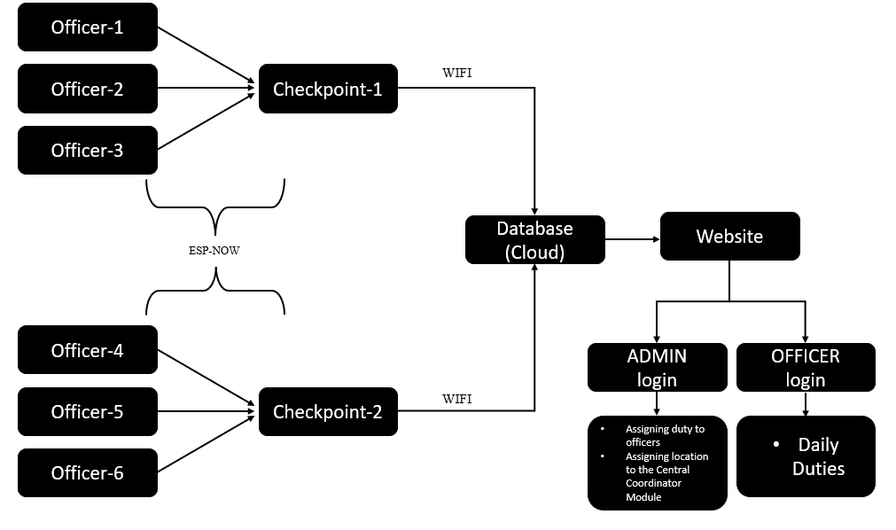
Idea/Approach Details
Description of Idea:
The proposed system consists of 3 parts viz.
A wearable device for police officer.
Central Coordinator module
Cloud storage and Web app
The Wearable device consists of a pulse rate monitor, to check whether the device is with the officer or not, and a transmitter to transmit the data to the central coordinator with the help of ESP-NOW protocol.
The Central Coordinator module coordinates all the wearable devices. During the period in which the device is worn, it will run a timer to keep watch on the duration for which the officer is in its vicinity. This data is then transmitted to the cloud using WIFI.
The web app consists of two sections. The first part will be controlled and operated by the admin to assign the bandobast duty to the officer and deployment of the central coordinator module. In the second part, the officer will be able to login and check his/her assigned task and location. A final summary of all the activity will be displayed in one webpage.
Technology stack used:
ESP-NOW
WIFI
ESP32
REST API
Supabase Cloud Service
Pulse Rate module
Software Technology

Slide 3
Idea/Approach Details
Use Case
Dependencies
Consider a situation where the police are given duty of managing a crowd for a certain public event. For this officers are assigned duty at particular locations/gates.
The admin has a login in the app through which he will assign the police officers with a patrolling route and their duty timings and duration.
Each officer is given an NFC wearable device containing a pulse rate sensor. They will be able to access their duty details through their respective app login.
The officers have to individually report to a single checkpoint over a period of time for his bandobast duties.
The ESP NOW allows the band to be connected to the central coordinator module.
The parent ESP receives the police officer’s band’s unique MAC address which then helps to fetch the police officer’s data from the data base. The time at which the officer is at the checkpoint is also recorded.
The purpose of the pulse rate monitor is to track the period of time for which the officer has the band on. The data is sent through the band’s ESP unit only when the band detects that the device is worn to ensure that the police officer himself is going to the checkpoints and not simply placing the device at the checkpoint location and leaving.
ESP-NOW
The ESP-NOW module is used for two way communication between ESP32 devices without using a Wi-Fi network. It can transfer 250 bytes of data and uses 2.4 GHz band without connecting or interfering with the local network connection. The main role of ESP NOW communication protocol is for connecting each officer’s band to the checkpoint’s ESP unit.
Supabase Cloud Service
Wi-Fi
Data from the central coordinator module will be sent to cloud services keeping internet as a medium with the help of Wi-Fi.
Showstoppers
Creating a database for all the police officers will be a relatively time-consuming and lengthy process.

Slide 4
Team Member Details
Sr. No. | Name of Team Member | Branch | Stream | Year | Position in team (Team Leader, Front end Developer, Back end Developer, Full Stack, Data base management etc.)
1 | Krish Jathare | B.Tech | EEE | 3rd Year | Team Leader
2 | Pratik Tadge | B.Tech | EEE | 3rd Year
3 | Subhendu Das | B.Tech | EEE | 3rd Year
4 | Harsh Brijesh | B.Tech | EEE | 3rd Year
5 | Remeka Majumder | B.Tech | EEE | 3rd Year
Team Mentors Details
Sr. No. | Name of Mentor | Category (Academic/Industry): | Expertise (AI/ML/Blockchain etc): | Domain Experience (in Years )
1 | P Sriramalaksmi | Academic
2 | Anantha Krishnan V | Academic

